Slide 1
sales story
File created on: 04/02/2022 18:56:26

Slide 2
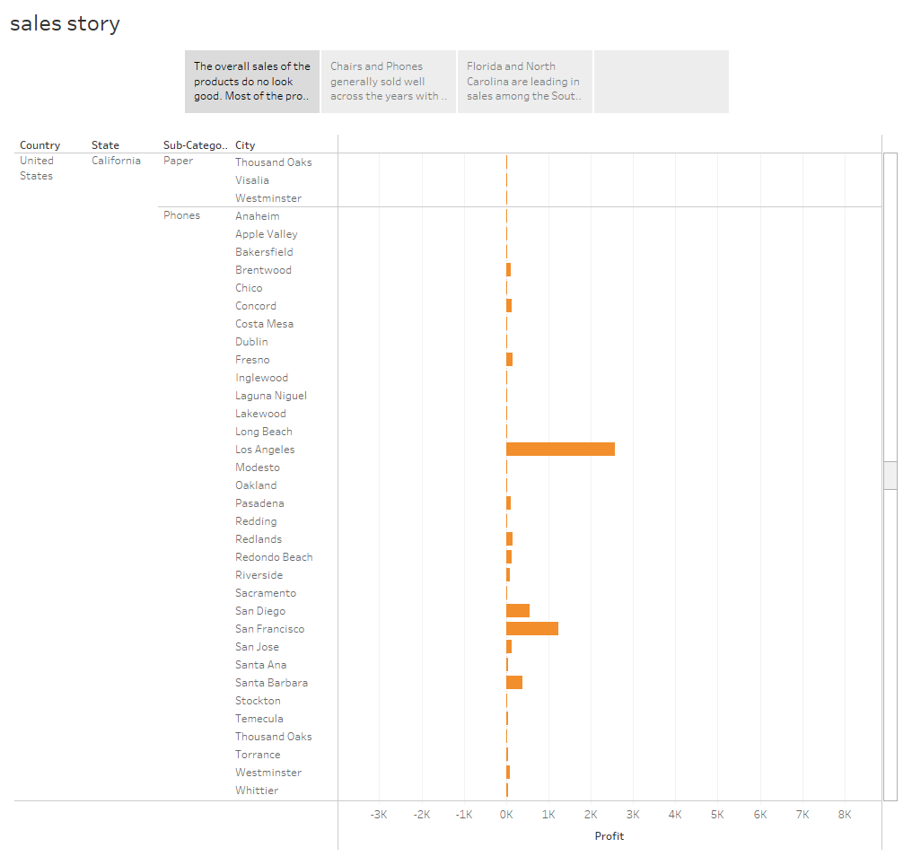

Slide 3
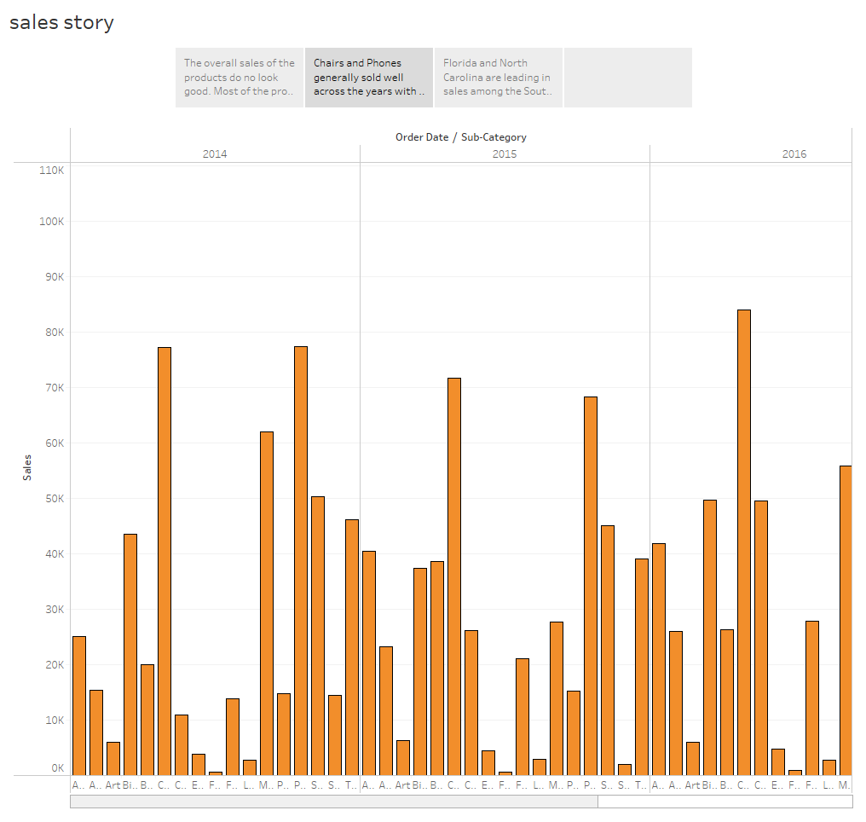

Slide 4
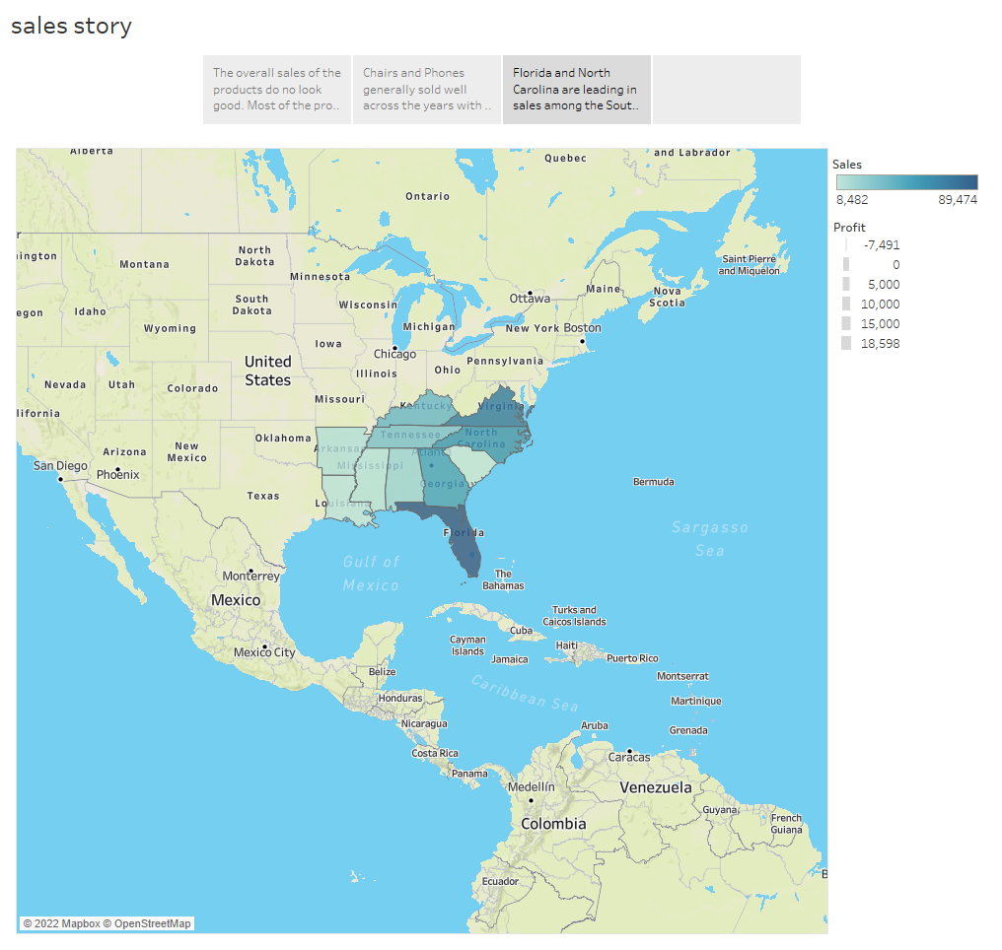

Slide 5
